Slide 1



Electronic Lab Notebook–
Digitize Your Experimental Designs And Results Into Wisdom From Discovery To Publication
ELN:次世代電子實驗記錄本之安裝與使用

Slide 2

Outline
Motivations
Introduction
ELN Interface
How to install?
ELN service control
How to use?
  Lab member
  Project leader
  Site manager

Slide 3
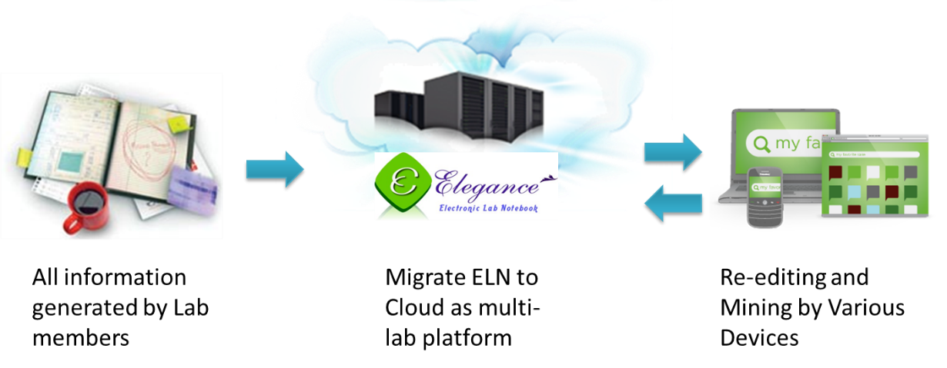
Motivations (1/2)
實驗室所產生的各類資料
儲存到雲端或個人電腦中
可在各種隨身設備上讀取修改

Slide 4
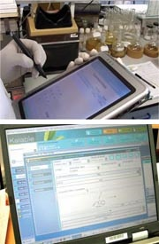
Motivations (2/2)
CMS : Content Management System
OpenSource
Sharing for multiuser
User friendly, easy control
Security, digitalized, pwd control
Knowledge reconstruction
Repository for ideas and knowledge
Remember anything in lab

Slide 5
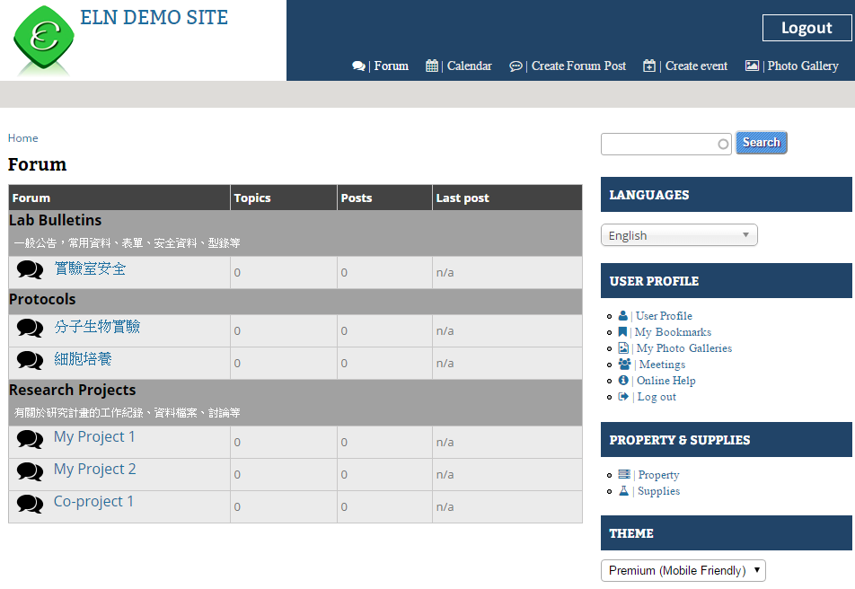
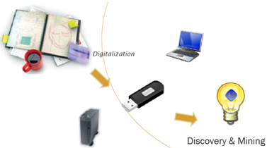
Introduction (1/4)
Using web page to digitalize and show your data

Slide 6
Introduction (2/4)
PLN vs. ELN
 | Paper Lab notebook (PLN) | ELN
Use | Easy | User-friendly interface
Read | Handwriting can be problematic | Easy
Annotation | Possible but space limitations | Easy
Modify | Difficult | Easy
Links within the pages | Unavailable | Just inserting hyperlinks
Search | Reading page by page | Easy
Sort | Unavailable | Sort by date, title, author…
Share | Need photocopying or scanning | Easy
Safety | Low control | Specific user permission
Accessibility | Specific place | Everywhere through internet
Long-term storage | Difficult | No problem
Pages numbered | Yes | Unavailable

Slide 7
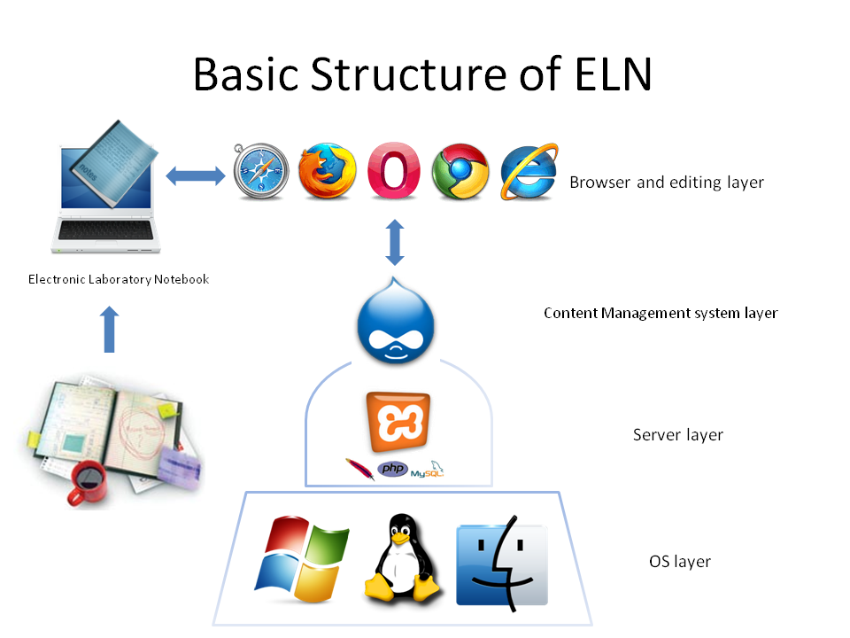

Introduction (3/4)
Drupal
PHP, MySQL, Apache

Slide 8
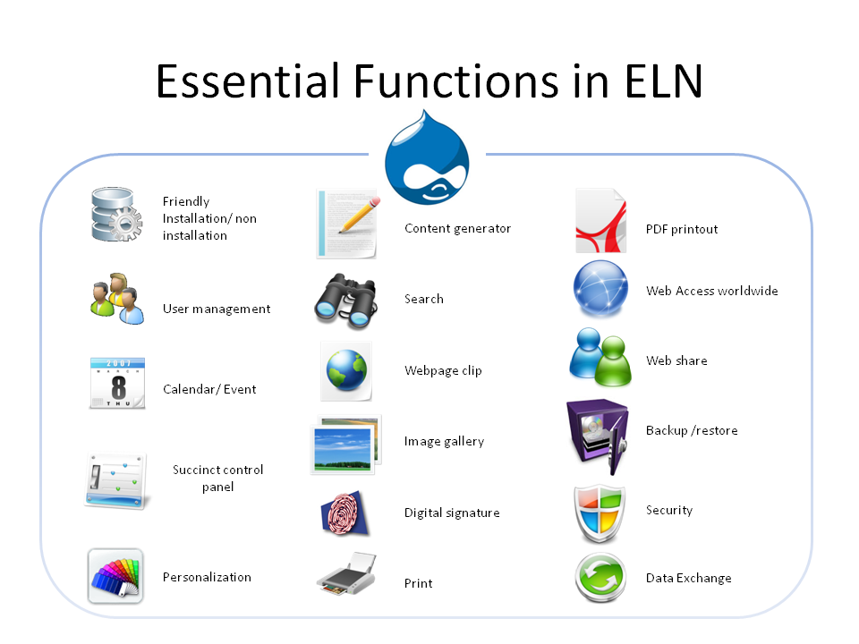
Introduction (4/4)

Slide 9


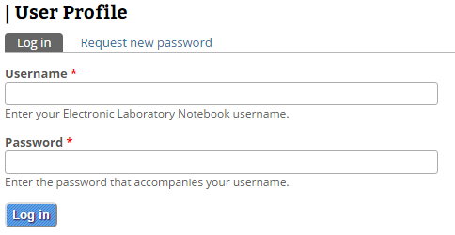


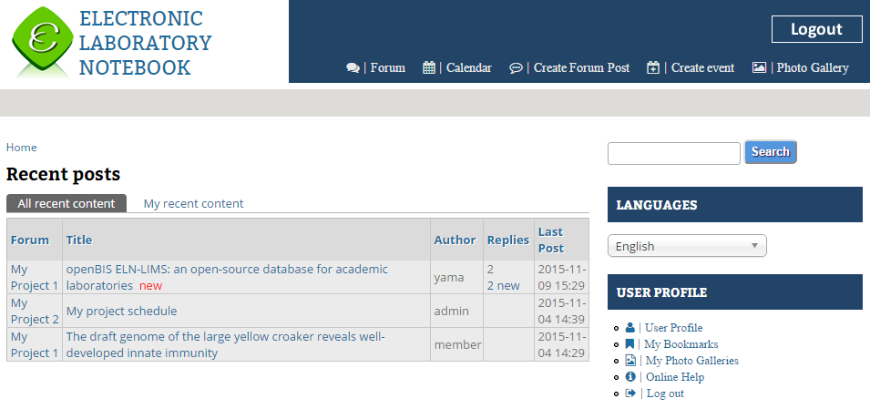
ELN interface (1/4)
One Installation, Two Sites
External Site for public Access/ Lab website
Internal Site for private Access

Slide 10
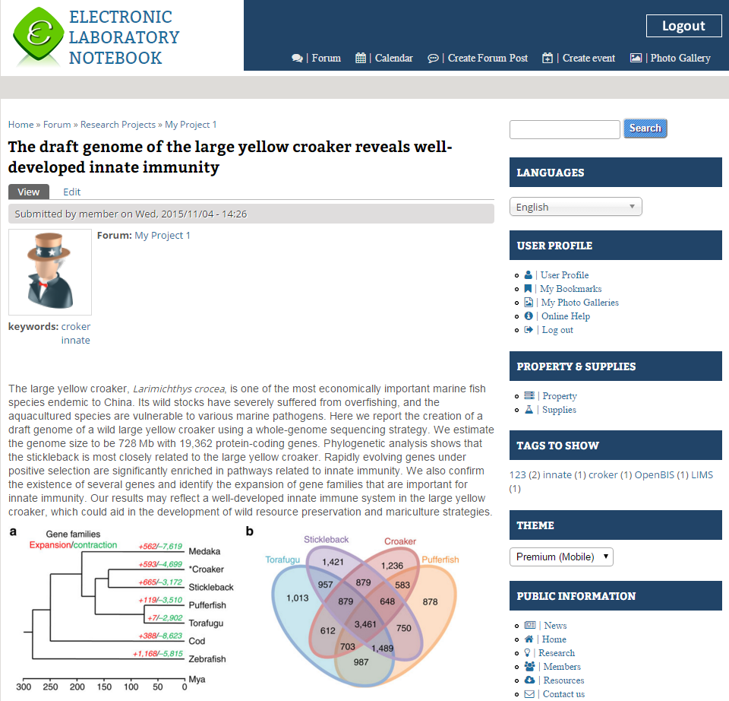
ELN interface (2/4)
Typical Interface
Search
Switch language
Record
Tag
Switch theme

Slide 11
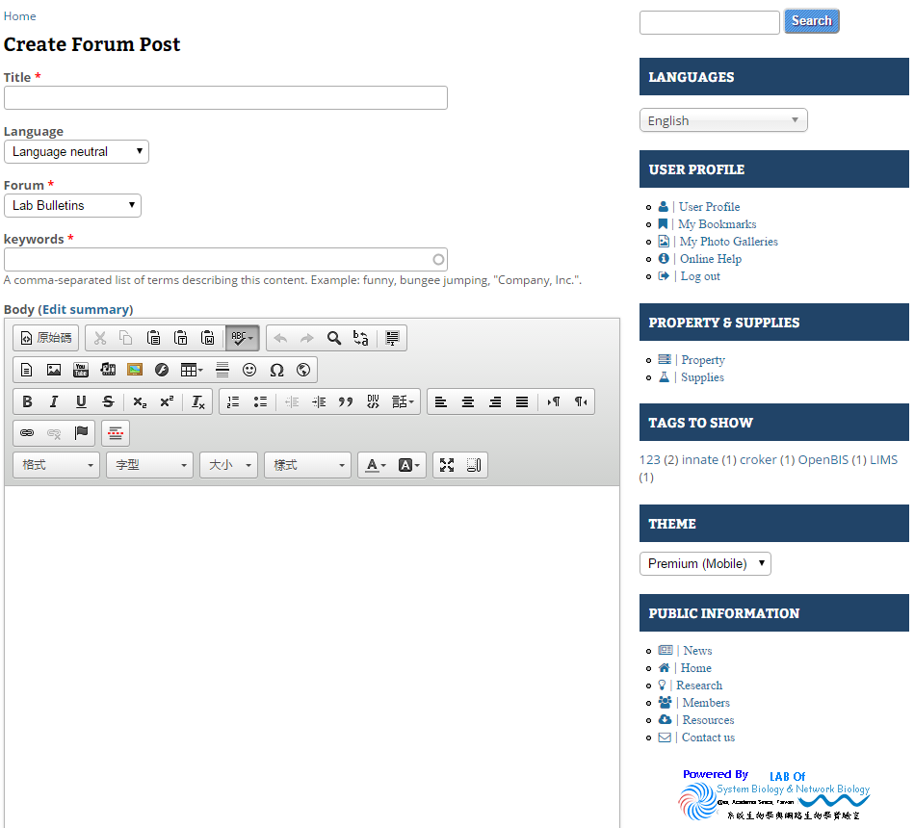
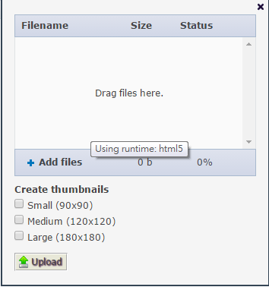
ELN interface (3/4)
Easy to editing content and appending table, image, file, youtube video…
Drag and drop your images or files

Slide 12
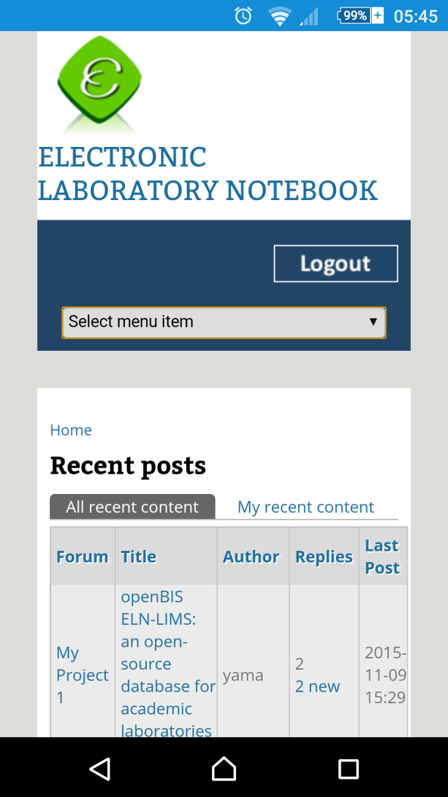
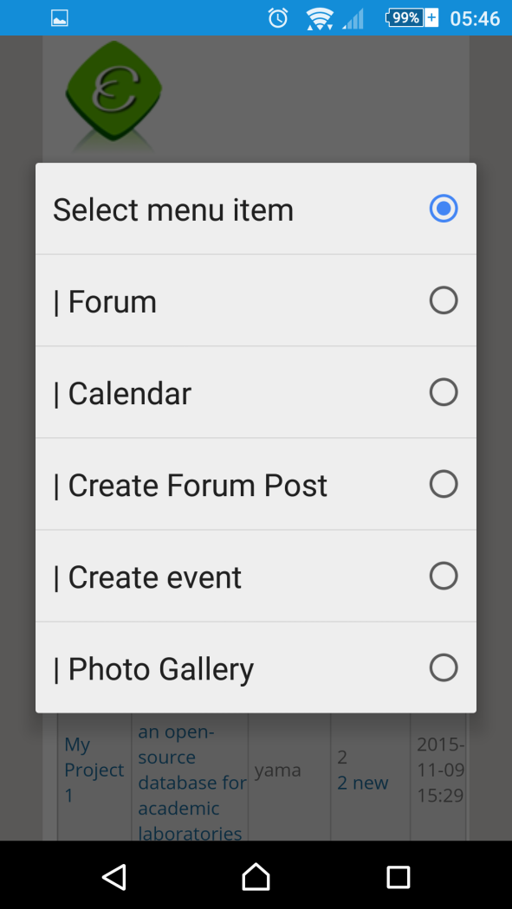
ELN interface (4/4)
More simple and clear layout in mobile device

Slide 13
Compare with other ELN SYSTEM
 | IARC ELN | openBIS ELN | Our ELN
Development Team | International Agency for Research on Cancer, France | Swiss Institute of Bioinformatics, Switzerland | Institute of Information Science, Academia Sinica, Taiwan
Methods | WordPress, PHP, MySQL | openBIS | Drupal, PHP, MySQL
Operating System | Linux | openBIS | Windows, Linux, Mac OS
Installation Steps | Install Linux, apache, MySQL, PHP Customize WordPress | Download VirtualBox image Install VirtualBox program to your OS Import VirtualBox image | Download installation file Enter your information step by step
Images and Files Management | Insert to single post | Insert to single post | Personalize folder, reuse
Editor(What You See Is What You Get) | Yes | No | Yes
Import data from file | No | Yes | No
Forum permission setting | No | No | Yes

Slide 14

System Requirement
CPU
  At least 1.6 GHz
Memory
  At least 4~8 GB
Hard disk
  A minimum installation requires 300 MB
  Suggest remaining 100 GB ~ 1TB free space for your files and images.

Slide 15
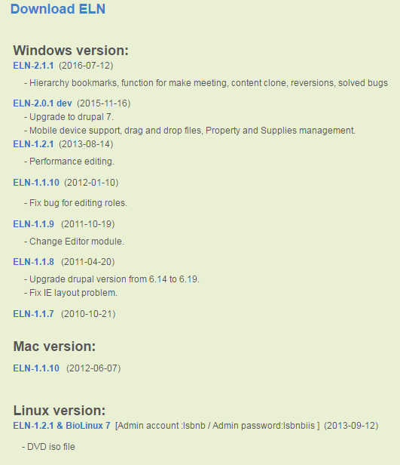
How to install?
Please go to this page to download the installation file
  http://eln.iis.sinica.edu.tw/eln/?q=download_eln
During installation, input site information step by step
  See the online help video http://eln.iis.sinica.edu.tw/eln/?q=help
Now we provide Windows, Mac and Linux version

Slide 16

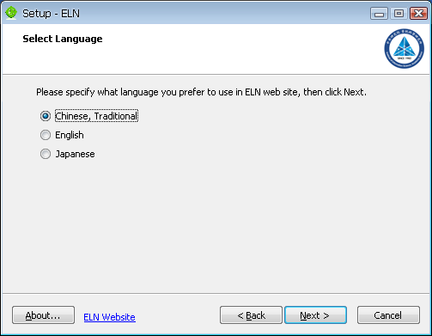
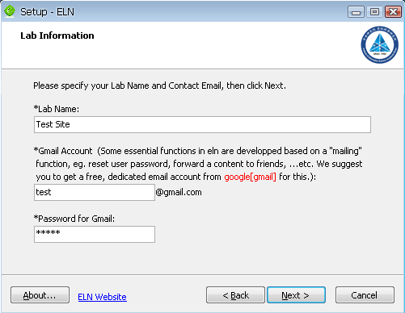
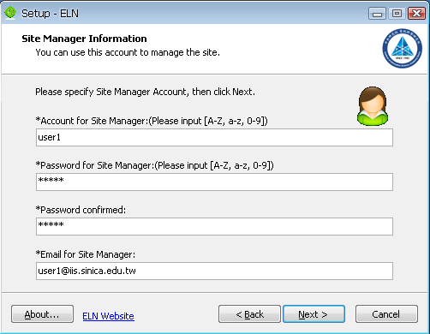
How TO INSTALL – Windows Version
Download the installation file and run it

Slide 17

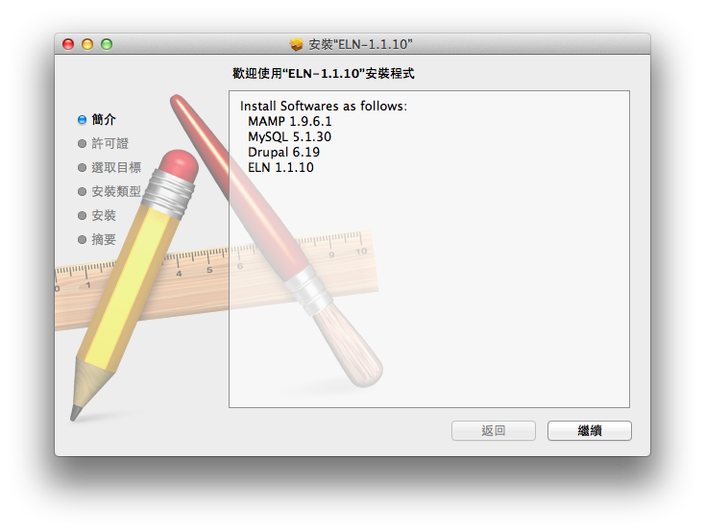
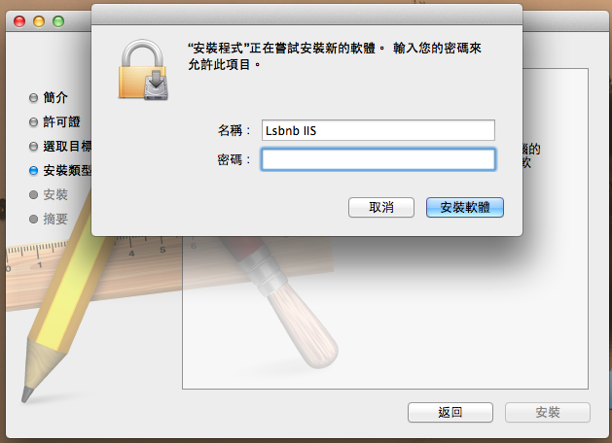
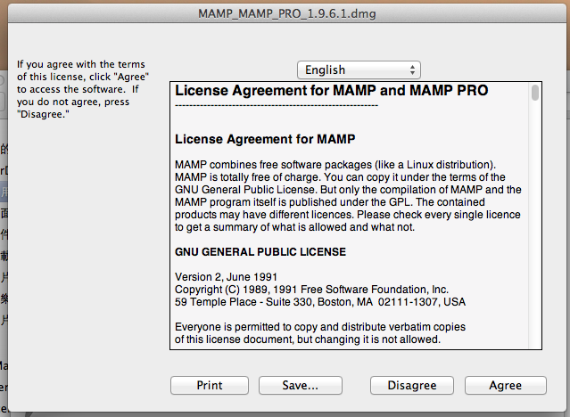
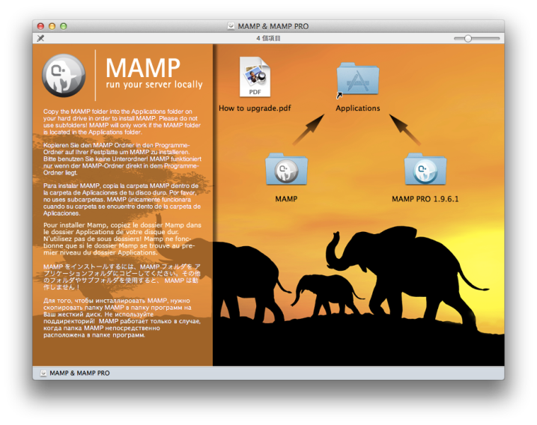
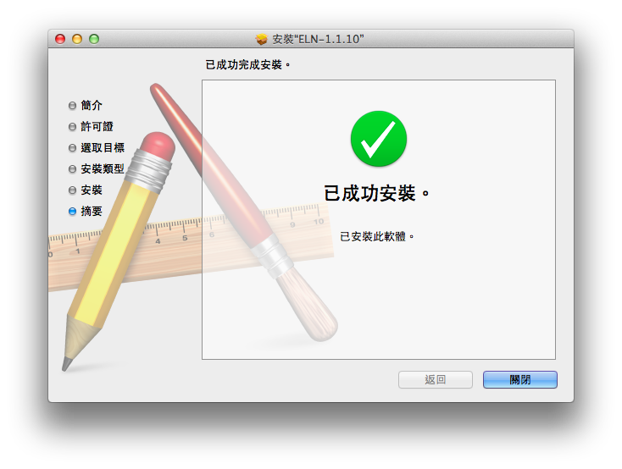
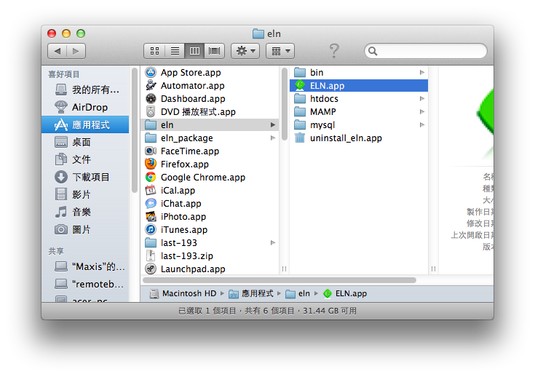
How TO INSTALL – Mac Version
Download the installation file and run it
Drog MAMP folder to Applications
Run /Applications/eln/ELN.app

Slide 18


How TO INSTALL – Linux Version (1/8)
Bio-Linux
  Provides more than 500 bioinformatics programs on an Ubuntu Linux 12.04 LTS base
  Develop by NERC Environmental Bioinformatics Centre
  Software included on Bio-linux
    http://environmentalomics.org/bio-linux-software-list/
Live DVD or install directly
Download the ISO file and burn it to DVD
Bio-Linux
ELN

Slide 19
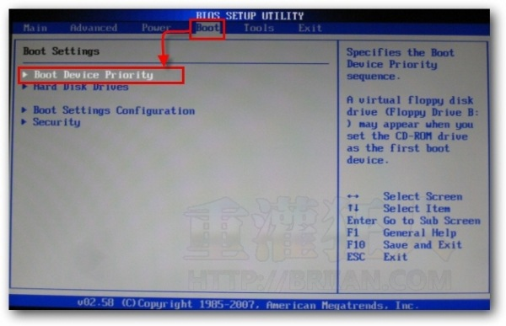
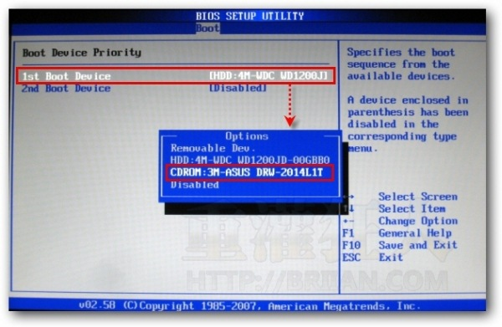
How TO INSTALL – Linux Version (2/8)
BIOS Setup
Set first boot device is CDROM

Slide 20
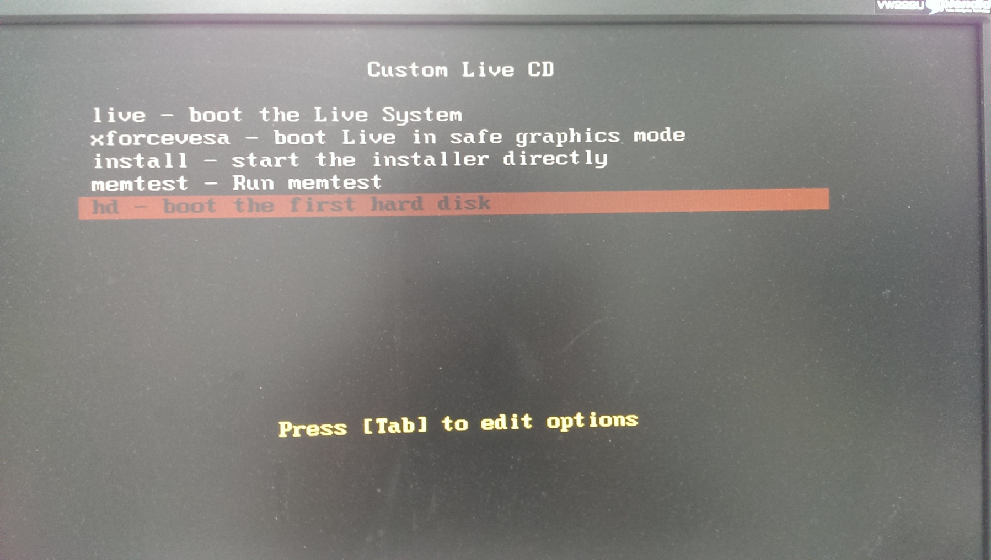
How TO INSTALL – Linux Version (3/8)
Insert the DVD into the DVD drive and restart your computer
You can boot from live CD or install directly

Slide 21
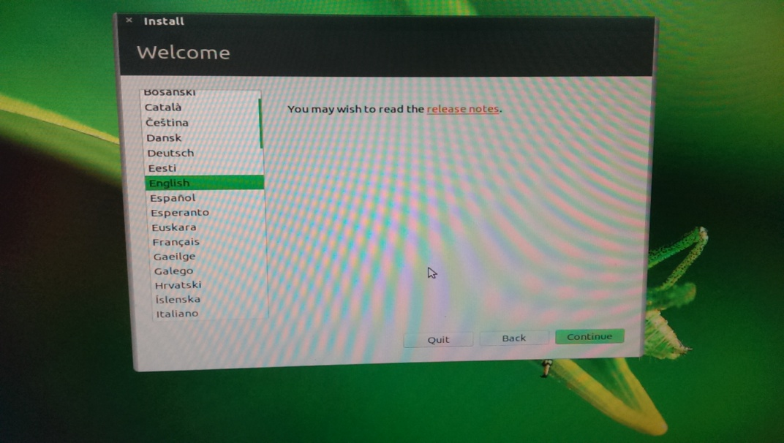
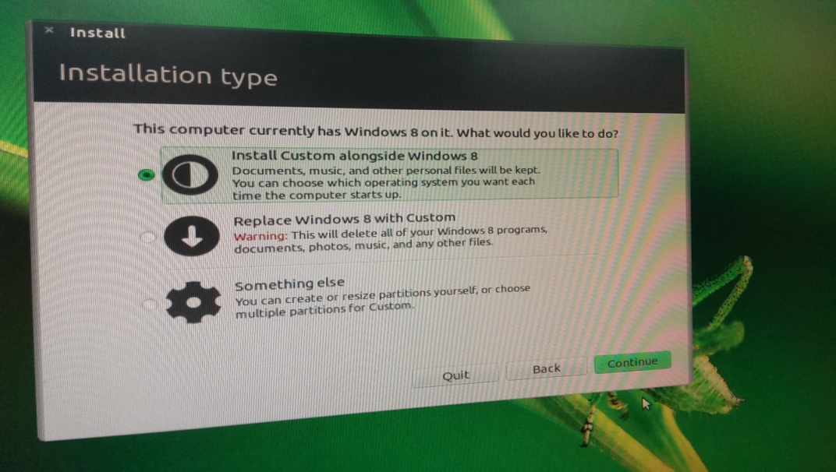
How TO INSTALL – Linux Version (4/8)
Select your language
Double system or only one

Slide 22
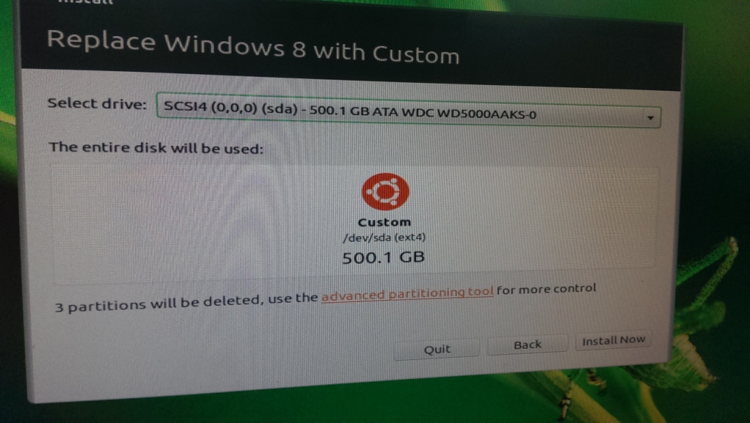
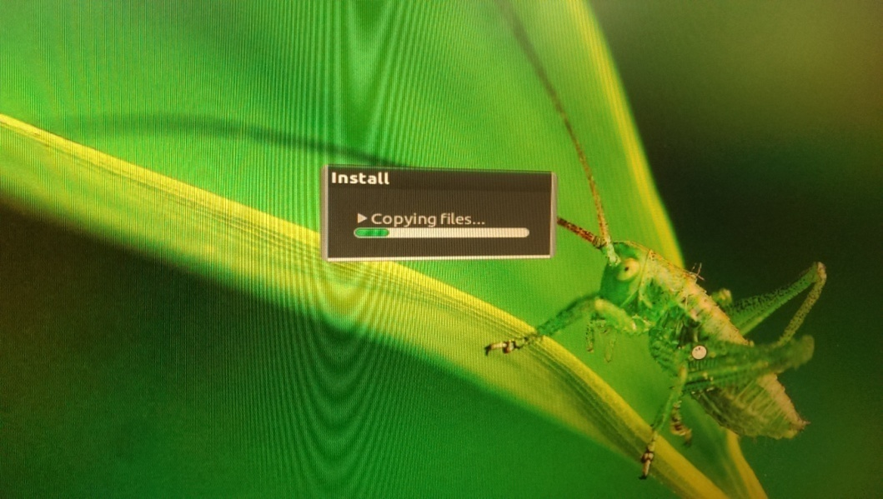
How TO INSTALL – Linux Version (5/8)
Select hard disk you want to install
Wait for copying files

Slide 23
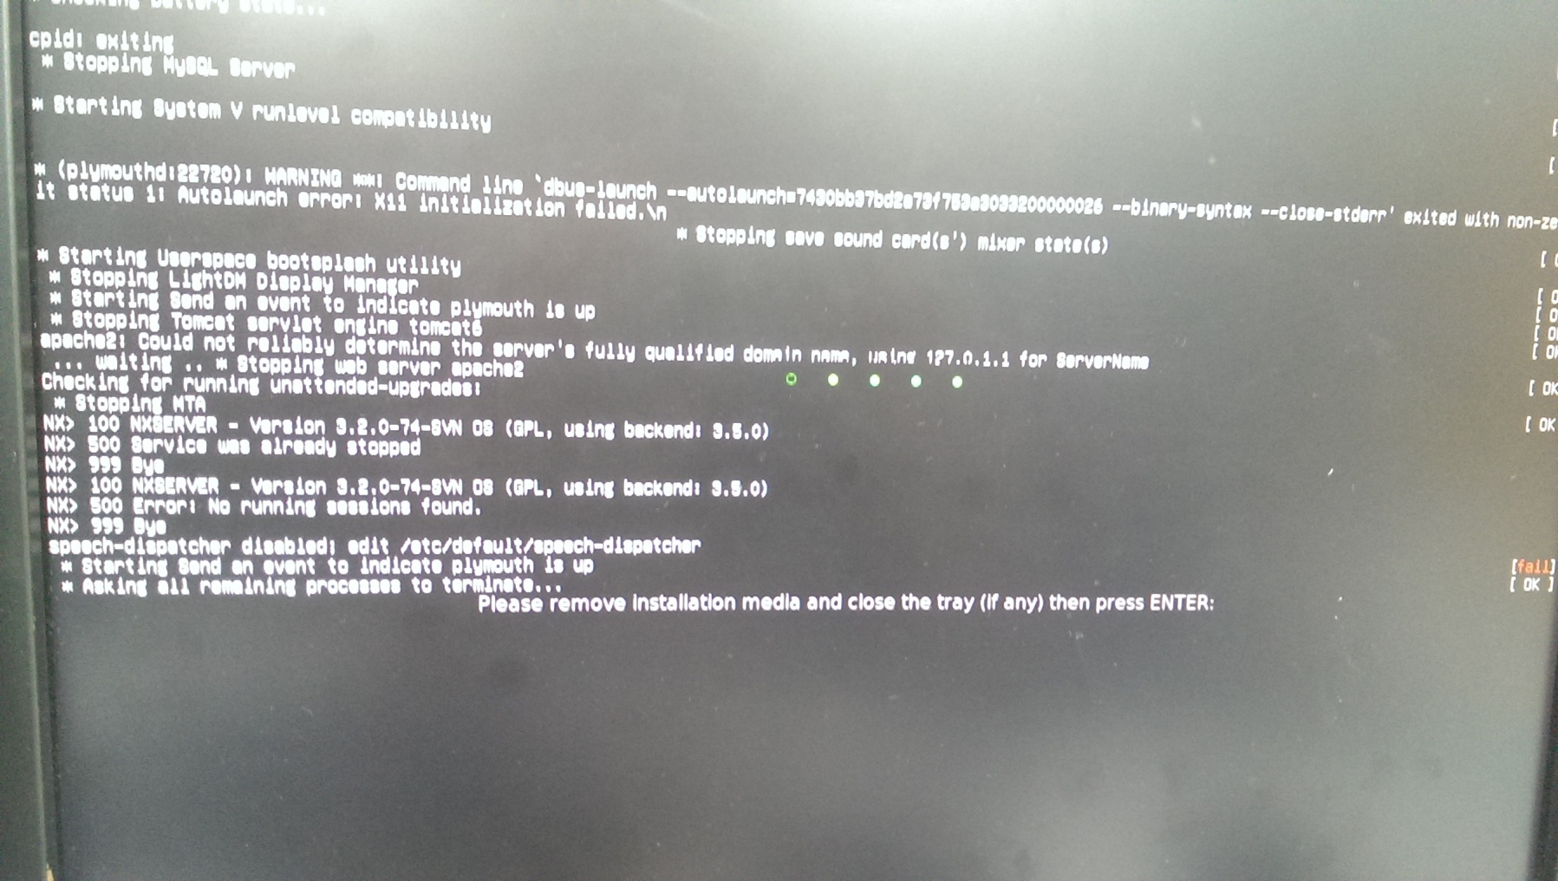
How TO INSTALL – Linux Version (6/8)
After installing, remove DVD and press Enter

Slide 24
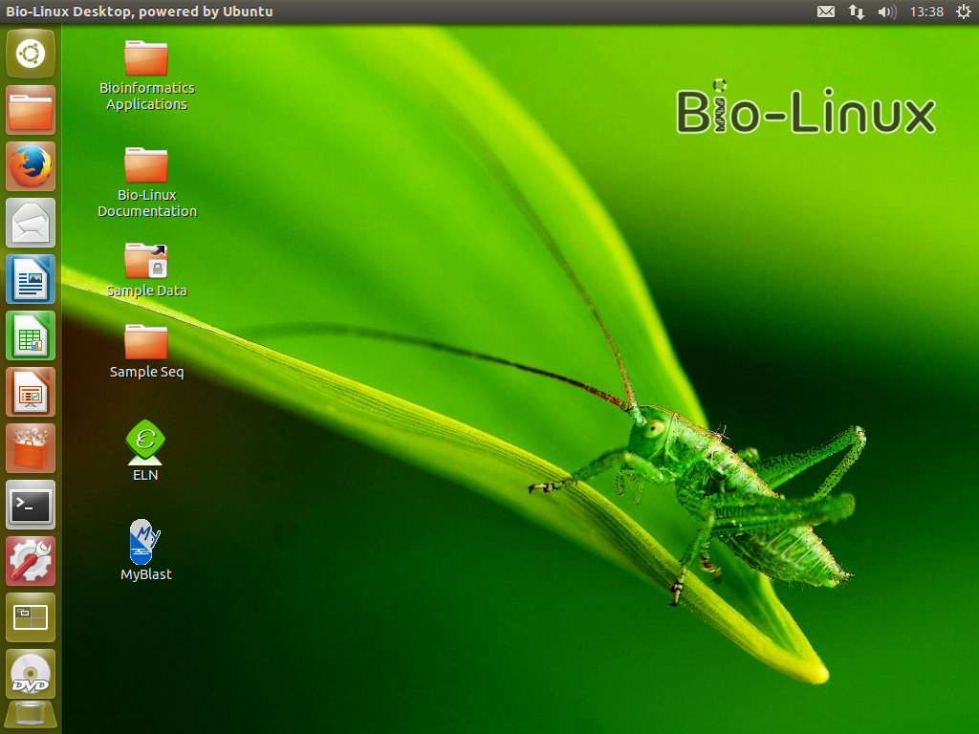
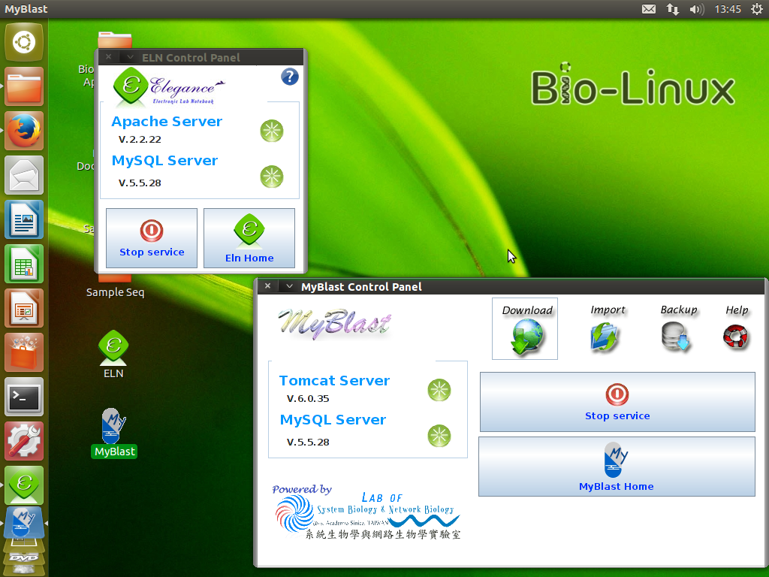
How TO INSTALL – Linux Version (7/8)
The screen capture after installing

Slide 25
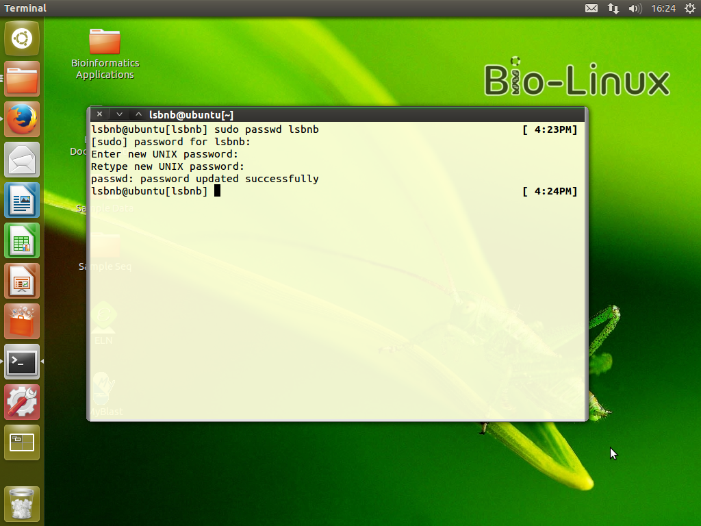
How TO INSTALL – Linux Version (8/8)
Change Admin Password
Open terminal
Enter “sudo passwd lsbnb”
Password for lsbnb is “lsbnbiis”
Enter new password

Slide 26
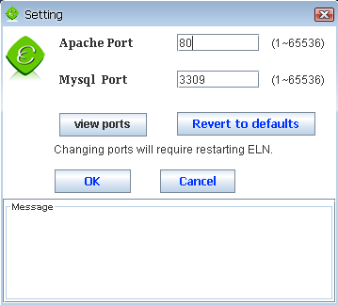
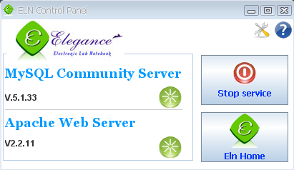
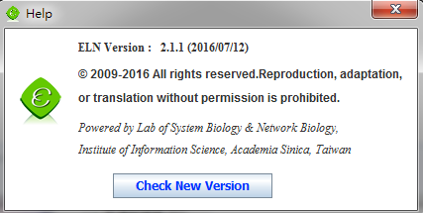
After installation, you will get ELN service control panel
3
Apache & MySQL server start/stop
Go to ELN home page
Change Apache & MySQL port
Check new version
4
1
2

Slide 27




Role Introduction
Guest
  Only can view public content
Lab member
  View public content
  View and post private content
Project leader
  Functions of Lab member
  Content permission management
Site manager
  User, content and
  theme management
Guest
Lab member
Site manager
Project leader

Slide 28

The Functions of Lab Member
Search
Personalization
Post and reply forum topics
Share content
  Convert to printer-friendly version or PDF file
  Email (hyperlink or full content)
See all reversions of content
Calendar
File management
Bookmark management
Photo galleries management
Make meeting invitation to other members
View properties and supplies in lab

Slide 29
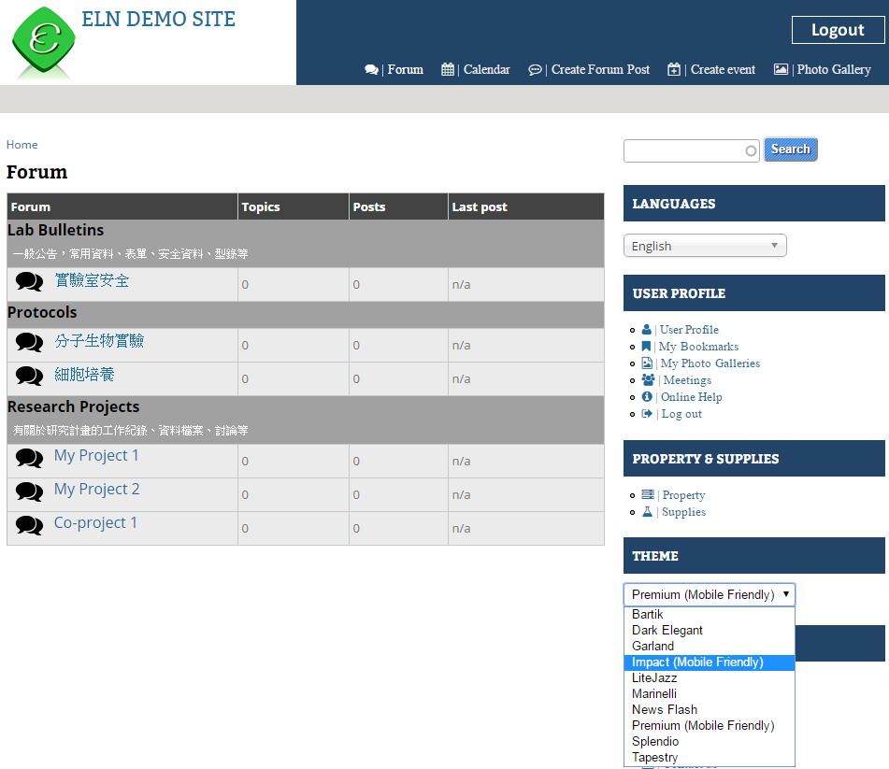
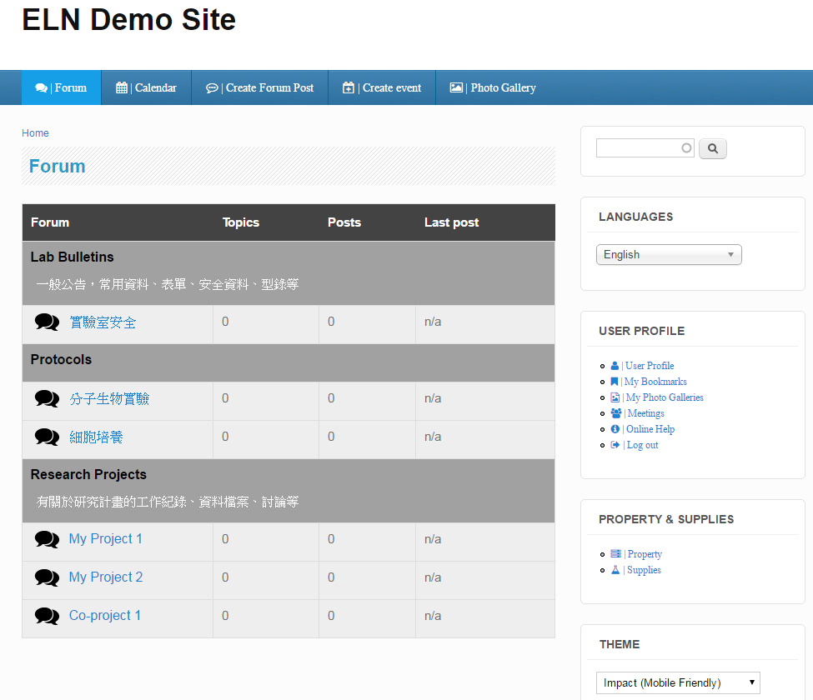
The Functions of Lab Member
- Search & Personalization
Search content, support autocomplete
Personalization, you can change theme here
1
2

Slide 30
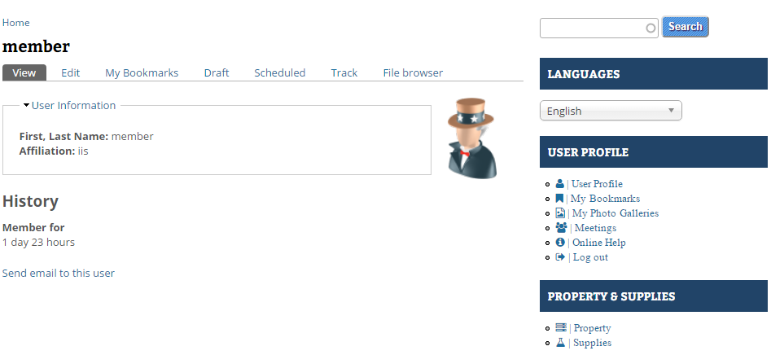
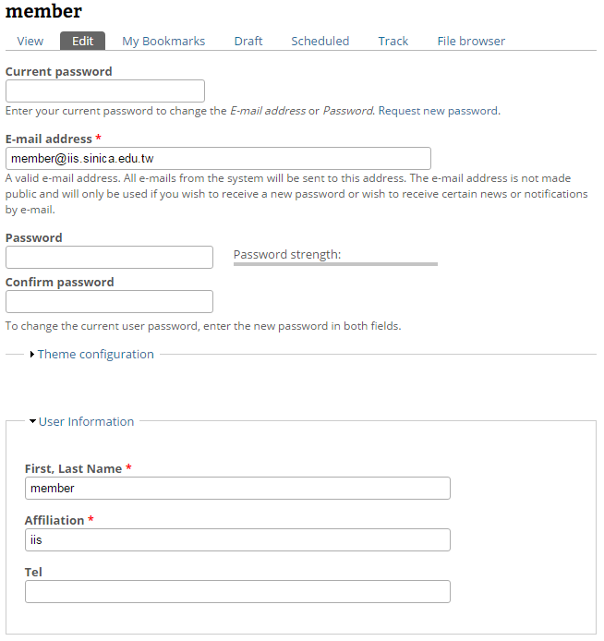
The Functions of Lab Member
- Profile edit
Click User Profile, you can see the user information
Click Edit, edit your account information
2
1

Slide 31
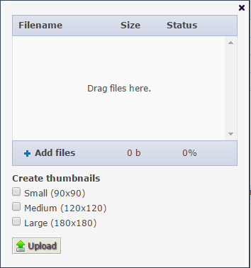
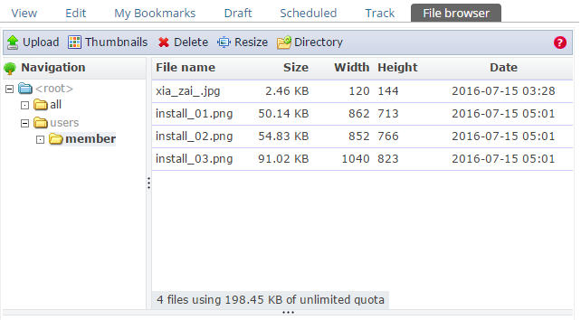
The Functions of Lab Member
- File management
Click File browser, management your files
Click Upload, show the upload window
Click Add files or just Drag the files
1
2
3

Slide 32

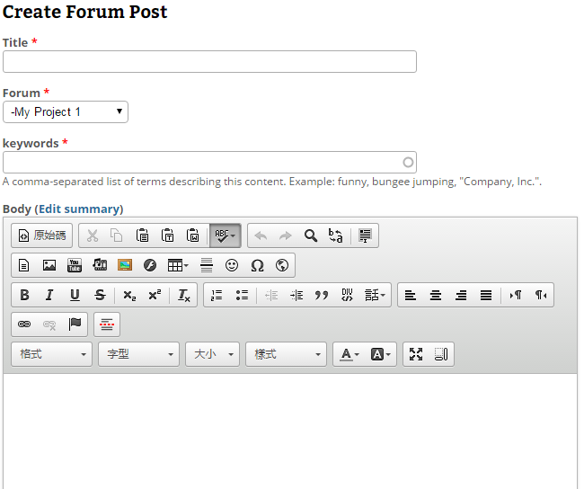
The Functions of Lab Member
- Post Forum
Click Forum, you can see the forums topics
Click Create Forum Post, you can add new content
Input Title, Forum name, Keywords and Body
1
2
3

Slide 33
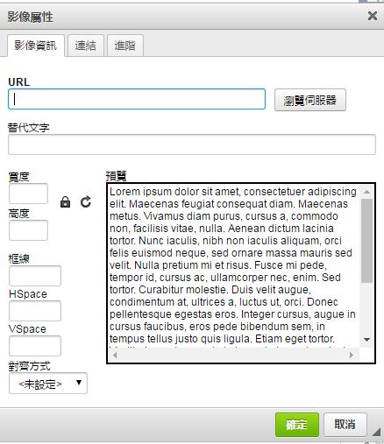
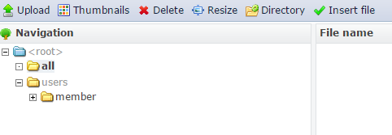
The Functions of Lab Member
- Insert image (1/2)
Click this icon, you can insert image file
Go to your file browser
Upload the image file
Insert the image file
2
1
3
4

Slide 34
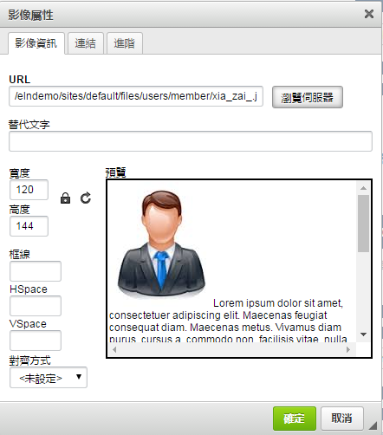
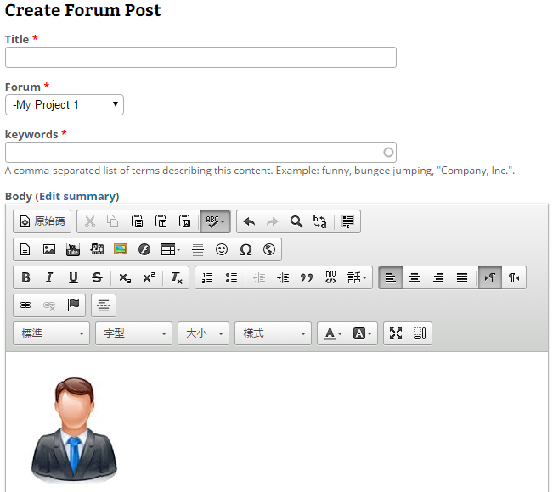
The Functions of Lab Member
- Insert image (2/2)
5. Adjust the width and height of the image
6. Insert image Success
5
6

Slide 35
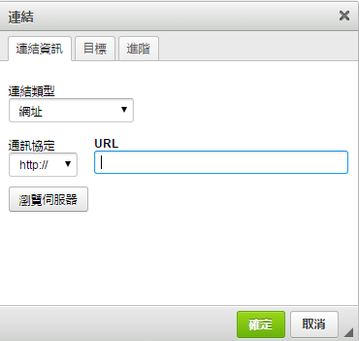
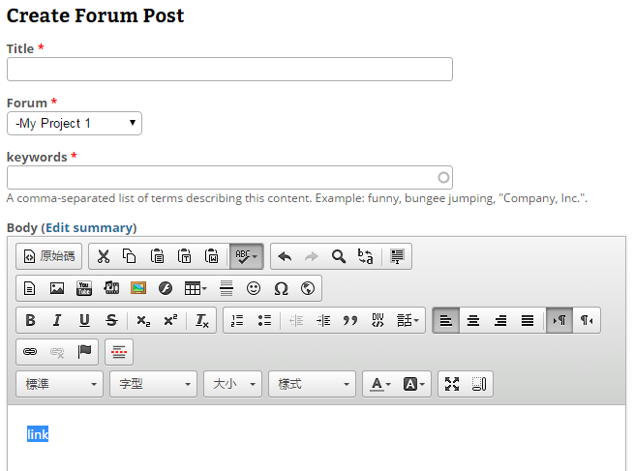
The Functions of Lab Member
- Insert file or hyperlink
Click this icon, you can make text or any file to hyperlink
Make text to hyperlink, input URL of the text
Make text to hyperlink for download the file, go to your file browser
Upload the file
Insert the file to hyperlink
2
3
1
4
5

Slide 36


The Functions of Lab Member
- Clone post & Add comment
Clone all the content of this forum post
Add comment about this forum post
Input Subject and Comment for discussion with other members
1
3
2

Slide 37


The Functions of Lab Member
- Share & bookmark content
Print, Email, or Convert this post to pdf
Add this post to your bookmark
Go to your bookmark management page
Re-order or create folder for you bookmarks
4
3
1
2

Slide 38


The Functions of Lab Member
- Revisions
Click Revision operations, you can see all the versions of this content
Click any time you want to see
1
2

Slide 39


The Functions of Lab Member
- calendar
Click Calendar, you can see Forum Post and Event
Click Create event, add event by your self
Input Event Title, Time and Description
1
2
3
Forum post
Event

Slide 40


The Functions of Lab Member
- photo galleries
Click My Photo Galleries, manage your Album
Input Album Title, upload photos
Set Album Privacy, share to Everyone, Lab member or Only yourself
2
1
3

Slide 41


The Functions of Lab Member
- Make meeting (1/4)
Click Meeting, make meeting invitation to other members
Input title and body
Input Date and Suggestion time for poll
1
2
3

Slide 42




The Functions of Lab Member
- Make meeting (2/4)
4. Check the time you are available 5. Invite other members by email
4
5
6. Input the email of members 7. Another member check the time he is available
6
7

Slide 43


The Functions of Lab Member
- Make meeting (3/4)
8. Click Meetings to decide the final meeting time 9. Click the meeting name
9
8
10. Click Edit 11. Decide the final meeting time
10
11

Slide 44


The Functions of Lab Member
- Make meeting (4/4)
12. Final time will show there 13. You also can see it in the calendar
12
13

Slide 45


The Functions of Lab Member
- Property & supplies (1/2)
Click Property or Supplies, you can see Property or Supplies page
Input condition for search
Click Property or Supplies Name, see details
2
3
1

Slide 46



The Functions of Lab Member
- Property & supplies (2/2)
4. Click Photo View, see pictures of Property or supplies
5. Click QR Code View, you can print QR Code and stick on Property or Supplies
6. Click Import & Export, go to Export to CSV file page
4
5
6

Slide 47
The Functions of Project leader (1/4)
Forum management
  Create, edit and delete forum topics
  Assign forums to privileged users
  Assign users to respective forums

Slide 48



The Functions of Project leader (2/4)
Forum Management
    Click Forum Management
    You can add forum and container (As the picture shows, Research Projects is a container and Project A , B C are forums)
    Use containers to group related forums
    Drag and drop the cross to re-order the forums
2
4
3
1

Slide 49


The Functions of Project leader (3/4)
Forum Permission – Assign by forums
  Click Forum Permission
  Click the forum which you want to adjust permission
  Check the account name then the user can access this forum
2
3
1

Slide 50


The Functions of Project leader (4/4)
Forum Permission – Assign by users
  Click Assign users
  Click the Assign link which you want to adjust permission
  Check the forum name then the user can access this forum
1
2
3

Slide 51

The Functions Of Site Manager (1/2)
Public information update
  News
  Home page, research topics, members information, resources
  Contact us (Show results, email list setting)
Site configuration
  Theme setting
  Upload setting
  Site information (Site name, footer message, …)
  Maintenance mode
  Backup and restore

Slide 52
The Functions of Site manager (2/2)
User management
  Create, edit and delete user
  Set role
Content management
  Post and comment management
  Forum management
    Create, edit and delete forum topics
    Assign forums to privileged users
    Assign users to respective forums
Property and Supplies management
  Import from CSV file
  Export to CSV file
  Make QR code for property and supplies

Slide 53


The Functions of Site manager
- News Management
  Click News Management
  Add, edit or delete News in this site
1
2

Slide 54


The Functions of Site manager
- edit menu
  Click Edit Menu, see all main menus in the site, you can edit or delete
  Enable or disable this menu
  Add new menu
1
3
2

Slide 55

The Functions of Site manager
- Public Information
  Edit static pages (Home, Research, Members, Resources)
  See Contact us Result / edit Contact us email list
1
2

Slide 56


The Functions of Site manager
- Upload setting
  Click Upload Setting
  Adjust upload quota of single user or total users and other settings about upload
2
1

Slide 57


The Functions of Site manager
- Site information & Footer message
  Edit Site name, Slogan and Email
  Edit Footer Message
1
2

Slide 58


The Functions of Site manager
- SMTP Authentication & Site Maintenance
  Edit Gmail account for sending email
  Change to Maintenance mode, only Site Manager can access your site
1
2

Slide 59

The Functions of Site manager
- Site Backup
  Click Site Backup
  Backup Database, Files or Entire Site
  Add schedule for backup
1
3
2

Slide 60



The Functions of Site manager
- User Management
  Click User Management, see all users list, you can search and edit users
  Click Add user, add new user account
  Input user name, email, password and belong role
2
1
3

Slide 61



The Functions of Site manager
- Content Management
  Click Post Management, see all articles in the site, you can search, edit and delete them
  Click Comments Management, see all the comments in the site
1
2

Slide 62

The Functions of Site manager
- Property & Supplies Management (1/3)
  If you need one Lab Member or Project Leader have ability to manage property & supplies,
  go to User Management editing this user, check Property_Supplies.
  If you are administrator(Site Manager), you had this ability and don’t need to do anything.
1

Slide 63



The Functions of Site manager
- Property & Supplies Management (2/3)
  2. Click Property or Supplies, go to Property or Supplies page
  3. Import & Export Property
  4. Click Add Property, go to create property page
  5. Input Property Name, Serial … etc
5
2
3
4

Slide 64

The Functions of Site manager
- Property & Supplies Management (3/3)
  6. Click Import from CSV file, go to import page
  7. Download a template and enter all the content you want to import
  8. Select the file you just complete
  9. Import the CSV file
  10. Export all property to CSV file
7
6
8
10
9

Slide 65
Related Links
ELN demo site
  http://elncloud.iis.sinica.edu.tw/elndemo
  Account for Lab Member (ID / Password = member / member)
ELN web site
  http://eln.iis.sinica.edu.tw/eln/
Installation program download
  http://eln.iis.sinica.edu.tw/eln/?q=download_eln
Online help video
  http://eln.iis.sinica.edu.tw/eln/?q=help
Contact as
  http://eln.iis.sinica.edu.tw/eln/?q=contact

